Slide 1

Explain seaborn
PRESENTED: BY KRISHNA KANT VERMA(1001)

Slide 2


Explain seaborn in python
Seaborn is a Python data visualization library built on top of Matplotlib that makes it easier to create attractive, informative, and statistical graphics with minimal code.
It is widely used for exploratory data analysis (EDA) because it integrates seamlessly with Pandas DataFrames and provides built-in support for statistical plots.

Slide 3

Key Features of Seaborn
High-level interface – Simple functions for complex plots.
Beautiful default styles – Better aesthetics than raw Matplotlib.
Built-in statistical plots – Histograms, boxplots, violin plots, heatmaps, etc.
Integration with Pandas – Works directly with DataFrames and Series.
Automatic handling of colors and legends – Reduces manual configuration.

Slide 4

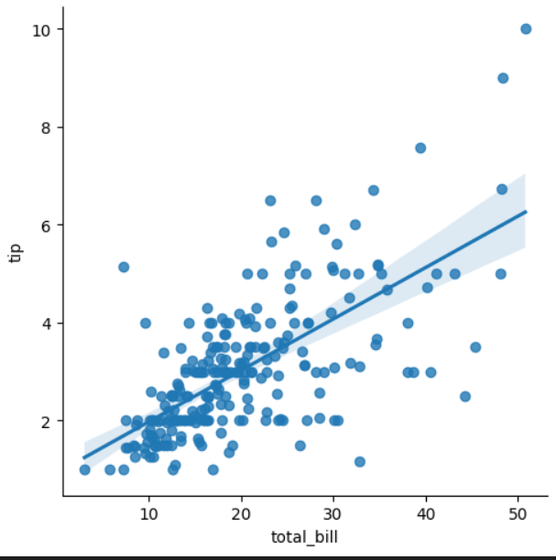
Installation
Bash
pip install seaborn
Basic Usage Example
python
import seaborn as sns
import matplotlib.pyplot as plt
import pandas as pd
# Sample dataset from seaborn
tips = sns.load_dataset("tips")
# Create a scatter plot with regression line
sns.lmplot(x="total_bill", y="tip", data=tips)
plt.show()

Slide 5

FUNCTION PURPOSE
sns.scatterplot() Scatter plot
Sns.line plot() line chart
Sns.bar plot() Bar charts with -------------------- statistical aggregation
Sns.count plot() Count of categorical values
Sns.box plot() Distribution and outliers
Sns.violin plot() Distribution + density
Sns.heatmap() Correlation matrices or 2D data
sns.pairplot() Pairwise relationships between variables
What happens here:
sns.load_dataset("tips") loads a sample dataset.
sns.lmplot() creates a scatter plot with a regression line automatically.
Common Plot Types in Seaborn

Slide 6

Example1: Heatmap
# Correlation heatmap
corr = tips.corr(numeric_only=True)
sns.heatmap(corr, annot=True, cmap="coolwarm")
plt.show()

Slide 7

✅ When to use Seaborn:
For quick, beautiful, and statistical plots.
When working with Pandas DataFrames.
When you want less manual styling compared to Matplotlib.
Python Seaborn Tutorial
Seaborn is a Python library built on top of Matplotlib, designed for creating attractive and informative statistical graphics. It simplifies data visualization by providing high-level interfaces for drawing various types of plots. Below are some key examples of Seaborn's capabilities and sample graphs you can create using it.
Example 1: Line Plot
import seaborn as sns
import matplotlib.pyplot as plt
# Load dataset
data = sns.load_dataset("iris")
# Create a line plot
sns.lineplot(x="sepal_length", y="sepal_width", data=data)
# Display the plot
plt.show()

Slide 8
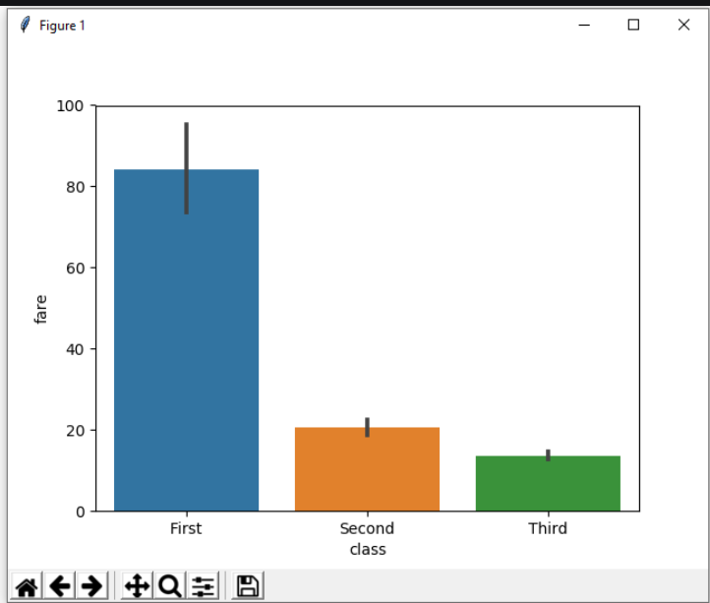
Example 2:bar plot
# importing the required library
import seaborn as sns
import matplotlib.pyplot as plt
# read a titanic.csv file
# from seaborn library
df = sns.load_dataset('titanic')
# class v / s fare barplot
sns.barplot(x = 'class', y = 'fare', data = df)
# Show the plot
plt.show()

Slide 9
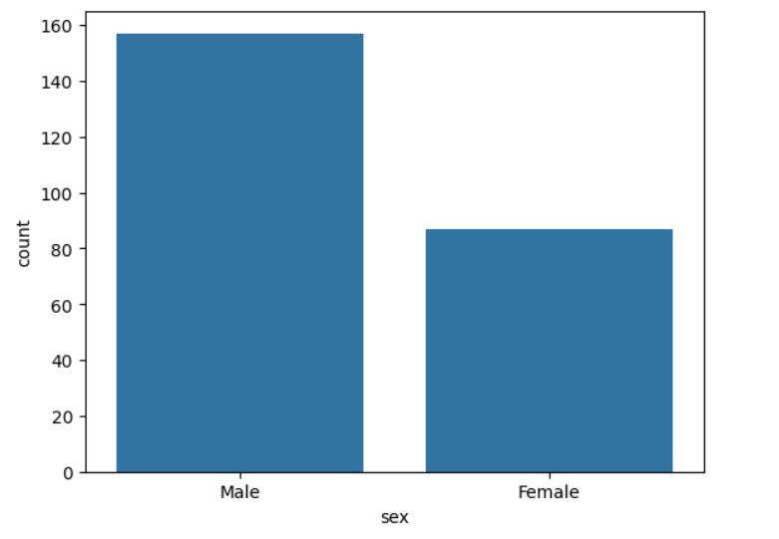
Example3:countplot
import seaborn as sns
import matplotlib.pyplot as plt
# read a tips.csv file from seaborn library
df = sns.load_dataset('tips')
# count plot on single categorical variable
sns.countplot(x ='sex', data = df)
plt.show()

Slide 10
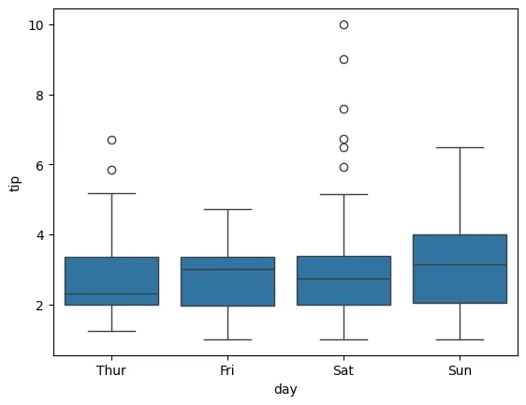
Example4:boxplot
import seaborn as sns
import matplotlib.pyplot as plt
df = sns.load_dataset("tips")
sns.boxplot(x="day", y="tip", data=df)
plt.show()

Slide 11
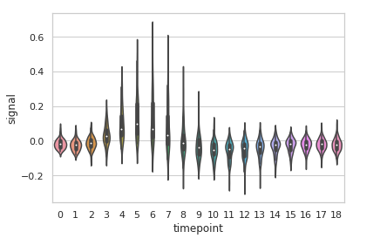
Example5:volinplot
import seaborn
seaborn.set(style = 'whitegrid')
fmri = seaborn.load_dataset("fmri")
seaborn.violinplot(x ="timepoint",
y ="signal",
data = fmri)

Slide 12
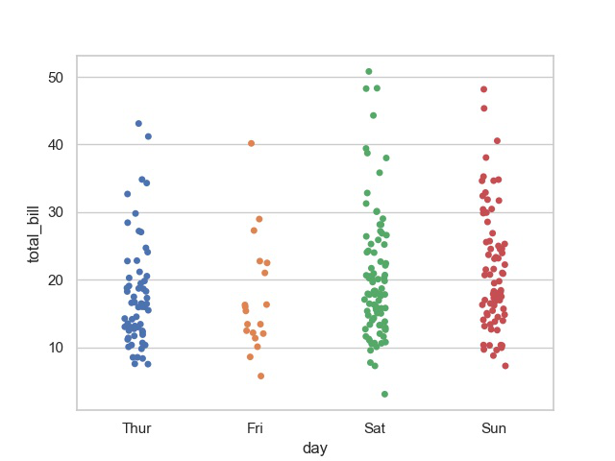
Example6:Stripplot
import seaborn
import matplotlib.pyplot as plt
seaborn.set(style = 'whitegrid')
tip = seaborn.load_dataset("tips")
seaborn.stripplot(x="day", y="total_bill", data=tip)
plt.show()

Slide 13
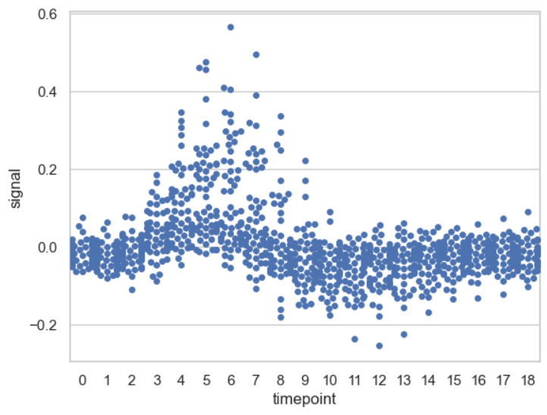
Example7:swarmplot
import seaborn
seaborn.set(style='whitegrid')
fmri = seaborn.load_dataset("fmri")
seaborn.swarmplot(x="timepoint",
y="signal",
data=fmri)

Slide 14
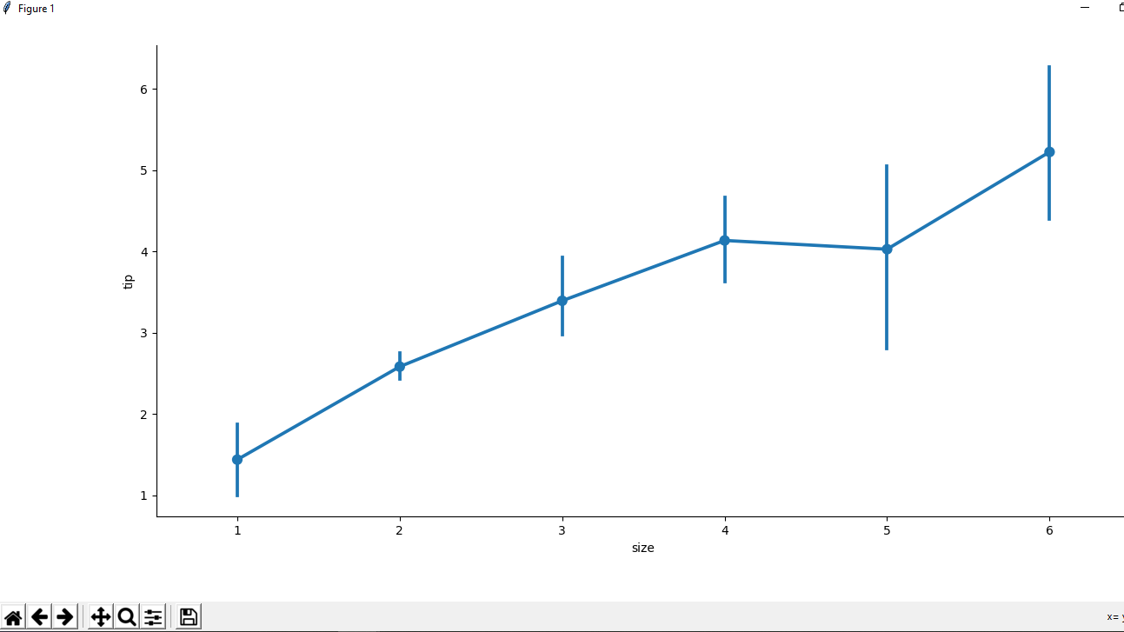
Example8:factorplot
# importing the required library
import pandas as pd
import seaborn as sns
import matplotlib.pyplot as plt
# read a csv file
df = pd.read_csv('Tips.csv')
# point plot(by default)
sns.factorplot(x ='size', y ='tip', data = df)
# Show the plot
plt.show()

